Slide 1
Class Diagram
Designed By: Tayyab Hanif Awan

Slide 2
Objectives
Concept of class diagram: Learning aspects and understanding of a class diagram and its properties.
Creating class diagram: Understranding basic features of creating a class diagram.

Slide 3
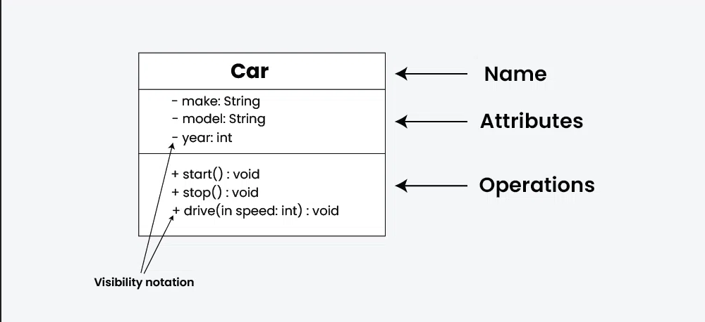
Classes
A class is a description of a set of objects that share the same attributes, operations, relationships and semantics.
Graphically, a class is rendered as a rectangle, usually including its name, attributes and operations in separate designates compartment.

Slide 4
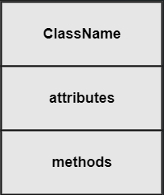
Class names
The name of the class is the only required tag in the graphical representation of a class. It always appear in the top-most compartment.

Slide 5
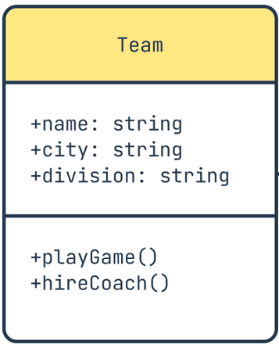
Class attributes
An attribute is a named property of a class that describes the object being modelled. In the class diagram, attributes appear in the second compartment just below name-compartment.
Attributes are usually listed in the form:
attributeName:Type
Attributes can be:
+ public
#protected
-private

Slide 6
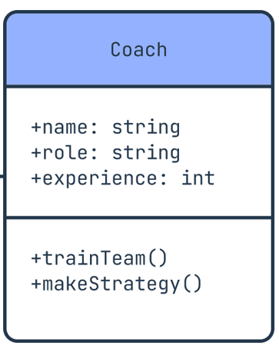
Class operations
Operations describe the class behavior and appear in the third compartment.

Slide 7
Relationships
There are two kind of relationships:
Generalization(parent-child relationship).
Association.
Association can further classified

Slide 8
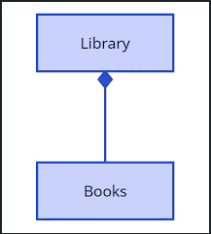
Composition
Composition expresses a relationship among instances of related classes. It is a specific kind of Whole-Part relationship .
It expresses a relationship where an instance of the whole-class has the responsibility to create and initialize instances of each Part-class.

Slide 9
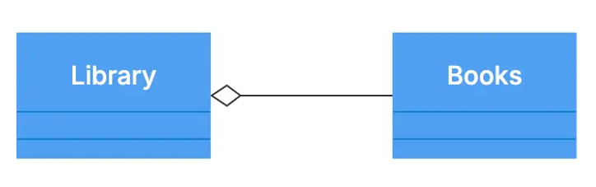
Aggregation
Aggregation represents a "has-a" relationship between two classes. It is a special form of association where one class contains or uses objects of another class but without owning their lifecycle.
The lifetime of the part is not managed by the whole.
If the container object is destroyed, the contained object can still exist.

Slide 10
Object diagram
An object diagram is a type of UML (Unified Modeling Language) diagram that represents a snapshot of objects and their relationships at a specific moment in time. It is used to model instances of classes (i.e., objects) and show how they interact in a particular situation.

Slide 11
Component of object diagram
Object:
Instances of classes, shown with the object name and class name
(object Name: Class Name).
Attributes:
Values the object currently holds.
Links:
Connections between objects (similar to associations in class diagrams)

Slide 12
Rules of object diagram
Object Naming:
Syntax:
Object Name: Class Name
If Unnamed:
:Class Name
Attributes:
Show only relevant attributes with their values.
No Methods:
Object diagrams do not show methods or behaviors.

Slide 13
Thank you

